Slide 1
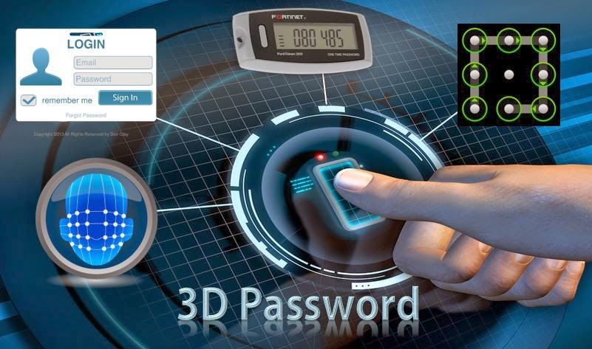
S.Niharika
M. Sai Anusha
II year, CSE
Pragati Engineering college

Slide 2
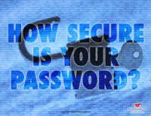
CONTENTS
Introduction
Existing system
Implementation
Working
Virtual environment
Advantages
Applications
Conclusion

Slide 3
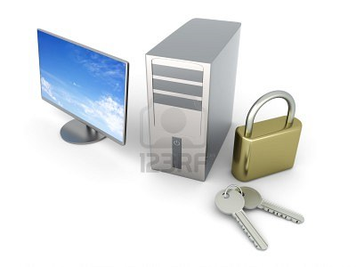
INTRODUCTION
Current Authentification suffer from many weakness.Textual passwords are commonly used,users do not follow their Current equirements.Users tends to choose meaningful words from dictionaries,which makes the textual passwords easy to break and vulnerable to dictionary or brute force attacks.In this ppt,we present and evaluate our contribution i.e. the 3D password

Slide 4
Existing systems:
Human Authentication Techniques
Textual Password
Knowledge Base
( What you know )
Graphical Password
ATM Card
Human Authentication Techniques
Token Based
( What you have )
Keys
ID Cards
Fingerprints,Palmprint
Biometrics
( What you are)
Hand Geometry
Face,iris,voice,retina

Slide 5
Drawbacks of Common Authentication Techniques
Textual Password:
Textual Passwords should be easy to remember at the same time hard to guess.
Graphical Password :
Graphical passwords can be easily recorded but some schemes take a long time to perform.
Token Password:
Most unsecured one, if stolen can breech through any security levels.
Biometric Password:
One main drawback of applying biometric is its intrusiveness upon a user’s personal characteristic .

Slide 6
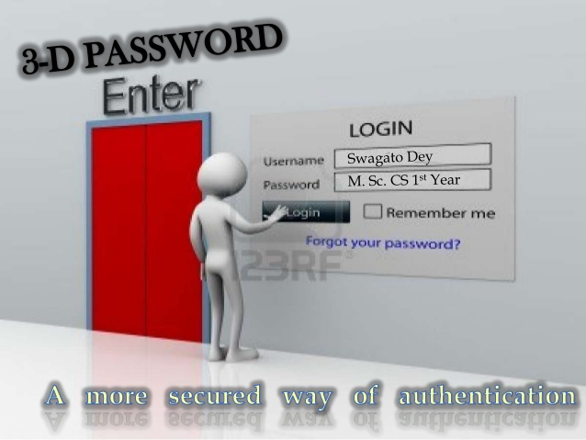
3D PASSWORD
A multi-factor authentication scheme.
The user log-in by navigating through a 3D environment.
The collected user actions and interactions in the 3D virtual environment construct the 3D password.

Slide 7
System Implementation
For example, the user can enter the virtual environment and type something on a computer that exists in (x1 , y1 , z1 ) position, then enter a room that has a fingerprint recognition device that exists in a position (x2 , y2 , z2 ) and provide his/her fingerprint. Then, the user can go to the virtual garage, open the car door, and turn on the radio to a specific channel. The combination and the sequence of the previous actions toward the specific objects construct the user’s 3D password

Slide 8
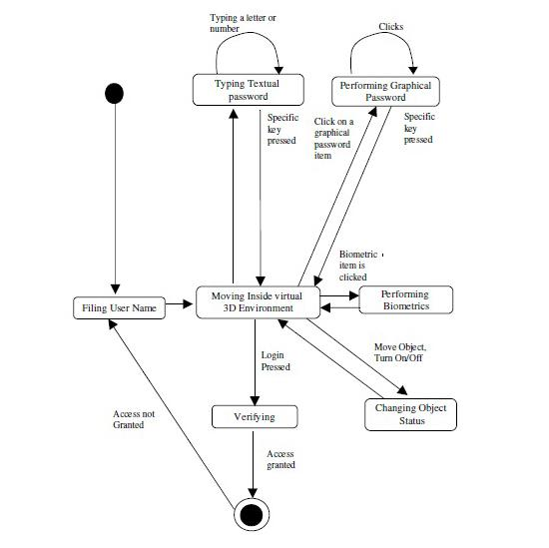
3D PASSWORD WORKING

Slide 9
3D VIRTUAL ENIVORNMENT
Snapshot of a proof-of-concept virtual art gallery, which contains six computers and 36 Pictures .

Slide 10
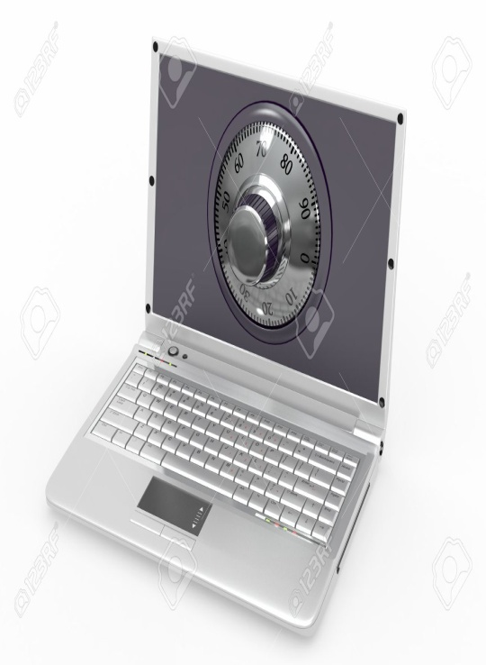

3D Passwords Advantages
Flexibility:3D Passwords allows Multifactor authentication biometric , textual passwords can be embedded in 3D password technology.
unbreakable: This scenario provides almost unlimited passwords possibility.
Ease to Memorize: can be remembered in the form of short story.
Respect of Privacy: Organizers can select authentication schemes that respect users privacy.

Slide 11
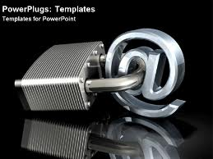
3D Password Application Areas
Critical Servers
Nuclear and military Stations
Airplanes and Jet Fighters
ATMs, Desktop and Laptop Logins, Web Authentication

Slide 12
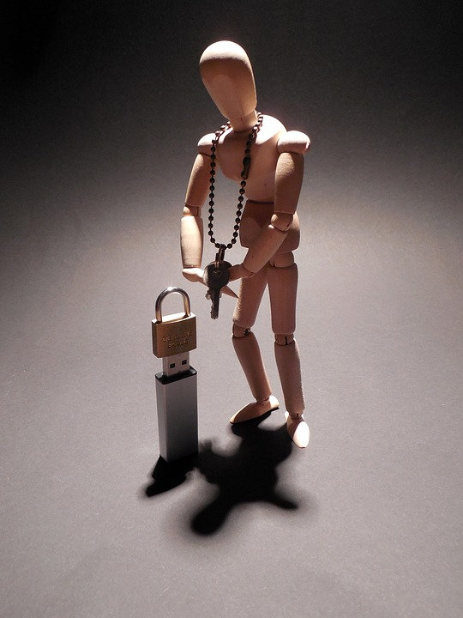
Conclusion
The authentication can be improved with 3d password ,because the unauthorized person may not interact with same object at a particular location as the legitimate user.
It is difficult to crack ,because it has no fixed number of steps and a particular procedure.
Added with biometrics and token verification this schema becomes almost unbreakable.

Slide 13


Slide 14

QUERIES

